Slide 1
TEAM-07
API and database:
Vishal Chandra jongoni cse 3/4
Vidyadhar pogul cse 3/4
Web application:
Sirnam Sanjana cse 2/4
Hyndevi Deshmukh cse 1/4
Surya mahati cse 1/4
Mobile application:
Keerthi Boya cse 2/4
Lavanya gandla cse 2/4
Saloni dayal cse 1/4

Slide 2
Problem Statement
Events App excluding shruthi sudhee
- login
- Register club with app details like head, description
- Admin manual verification required
- Schedule an event (upload info regarding an event - dates,description,participation criteria, cert
etc)
- Provide reg forms
- add/delete/modify events
- END USERS - ONLY VIEWERS
- Login with roll no
- View events in upcoming and ongoing and past fashion
- Can enroll to an event through reg forms
- View enrolled/interested events in my events part
- Reminder about registered event (1 day prior and on the day 9am -default )
- Change settings - user info, reminder timings, unroll
- Provide means to text the club head (club page)
- ADMIN MODULE
- login
- Allow/ deny permission to clubs
- View club page content- request to delete through message/ delete content(event)
- View DB tables, insert/modify/delete info

Slide 3
Technical Details
Hardware Requirements
Laptop/PC with a minimum of 4GB RAM
Smart phones with android based OS
Software Requirements
Python latest version
Django(python web framework)
Mysql
Flask(python web framework)
Postman tool
Android Studio
Java
HTML,CSS,Bootstrap,Javascript

Slide 4
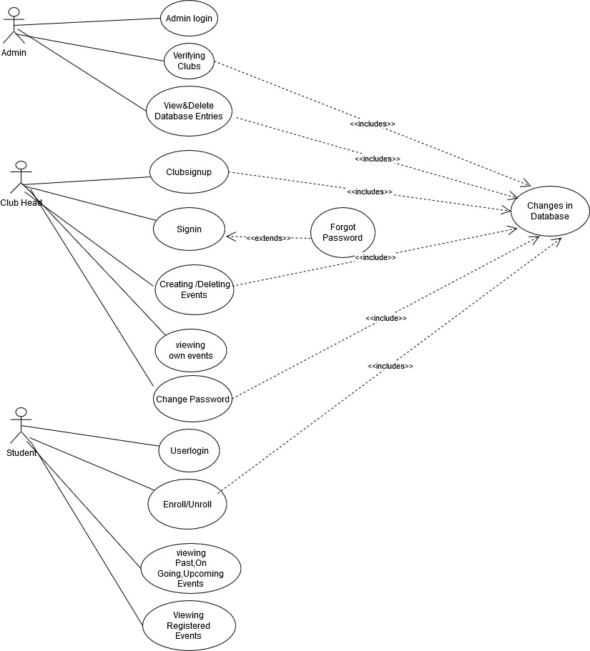
Use Case Diagram:

Slide 5
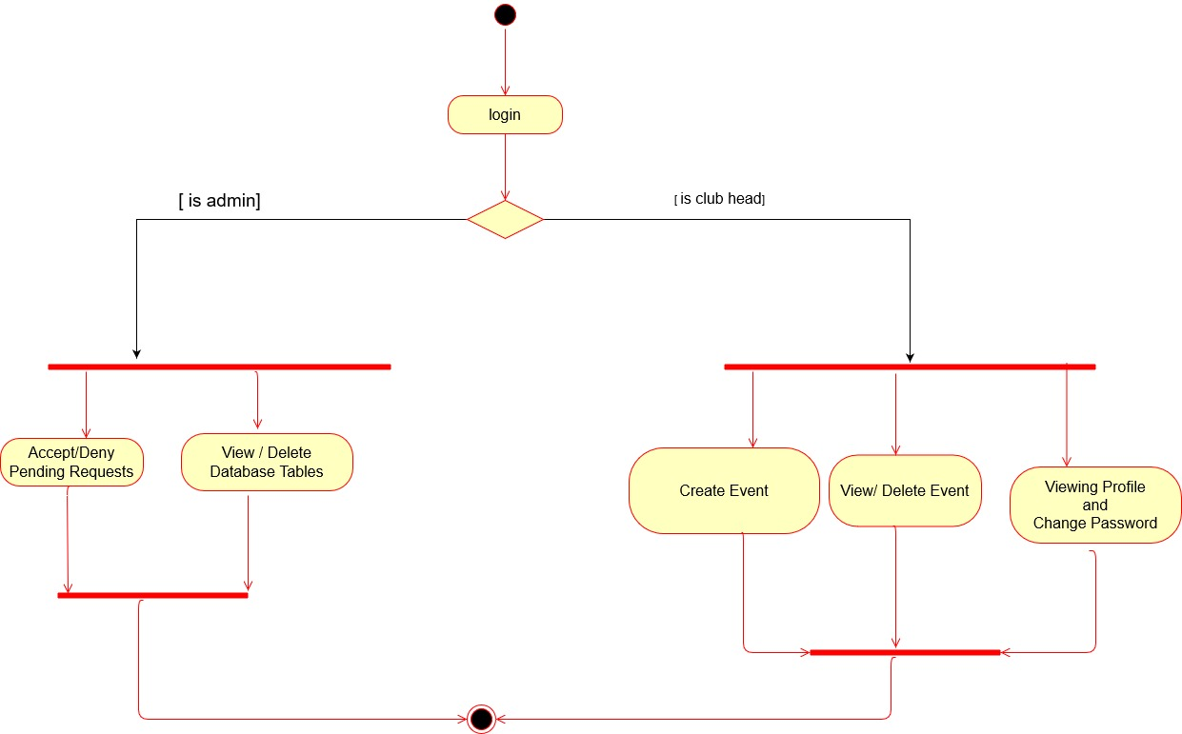
Activity Diagram for our web application

Slide 6
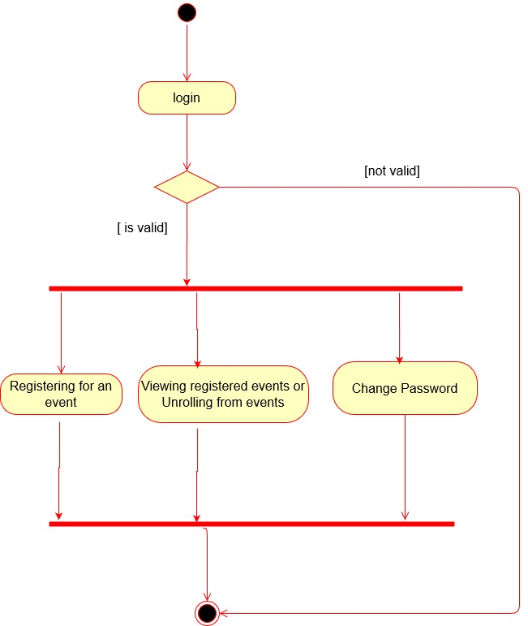
Activity Diagram for our Mobile application

Slide 7
Our Solution Contains three modules:
Web Application
Mobile Application
Rest APIs and Database

Slide 8
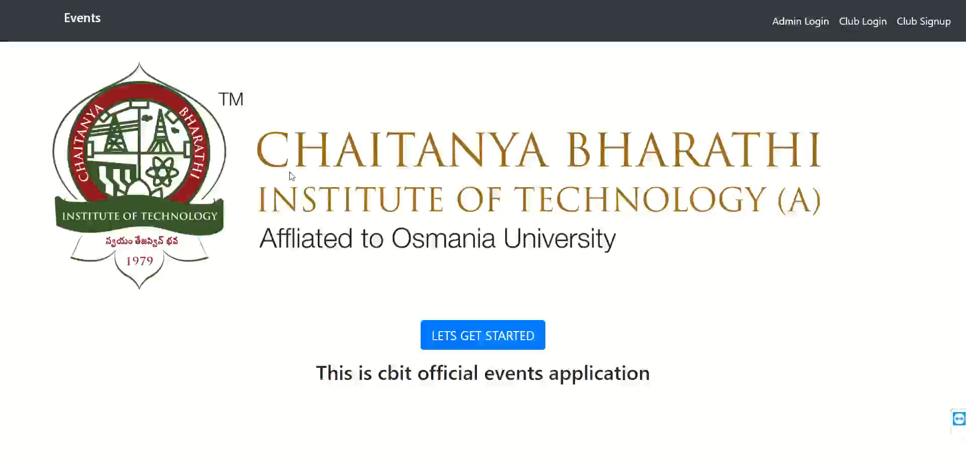
Web Application
This module is used by admin and club heads.
It is used by admin to accept or deny club registrations and view or delete any database entries.
It is used by the club heads to create and manage their events.
It’s built using Django framework and HTML, CSS, JavaScript, Bootstrap.

Slide 9
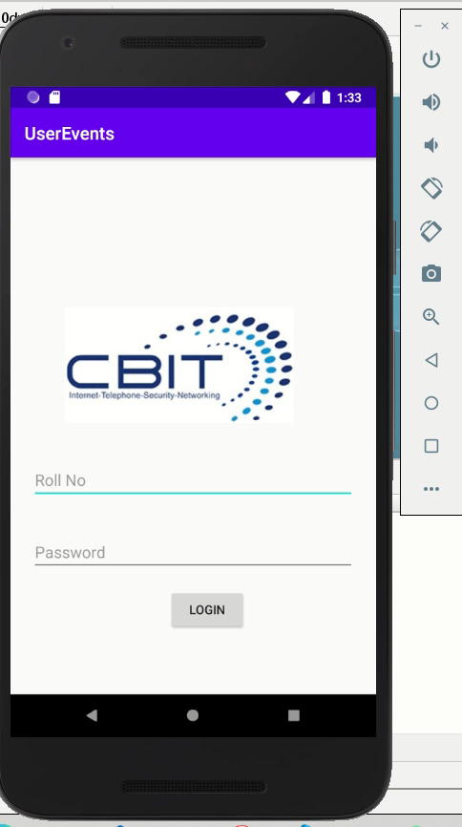
Mobile Application
This module is used by end users(students) to view the past, ongoing or upcoming events and register accordingly.
They can also view their registered events and get a notification to them one day prior to its start date.
Android using Java is used to develop this application.

Slide 10
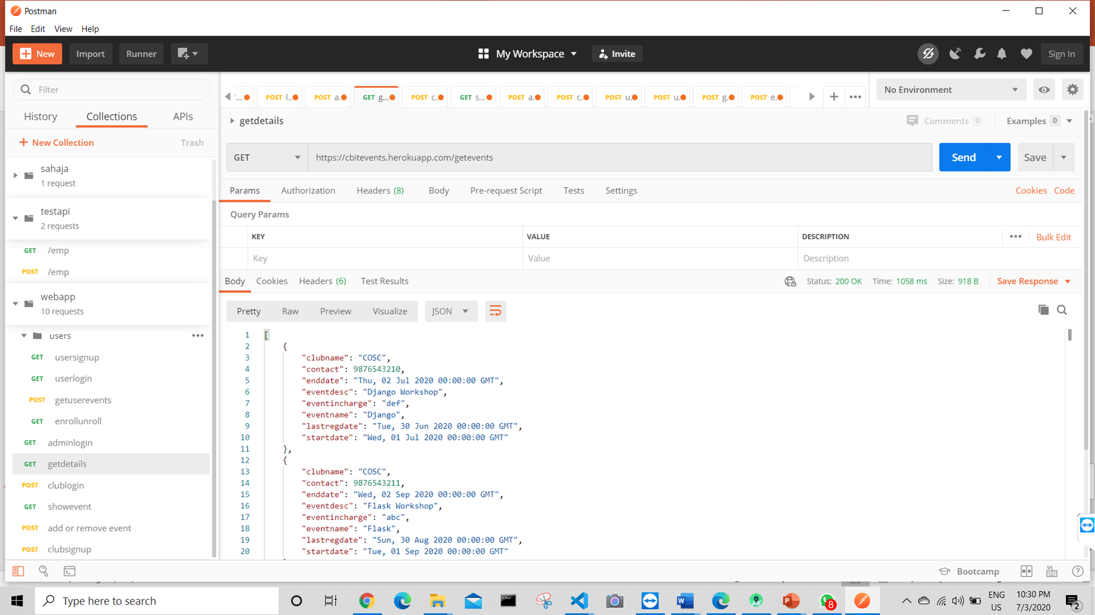

FLASK RESTful APIS and Databse
This module defines the API calls by executing the required queries and return the data.
They are written in Flask with the help of restful api’s and the database used is MySQL.
Postman tool is used to test these API calls.

Slide 11
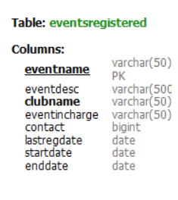
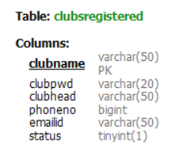
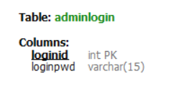
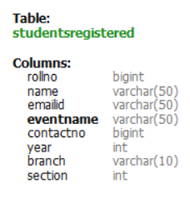
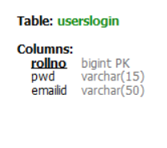
Our database has 5 tables(admin, userslogin, clubsregistered, eventsregistered, studentsregistered).
admin table has loginid as primary key.
userslogin table has rollno as primary key.
clubsregistered table has club name as primary key.
eventsregistered table has eventname as primary key and club name as a foreign key.
students registered table has eventname as foreign key.

Slide 12
THANKS
Any questions?
Special thanks to our project mentor Sriram Valiveti
for his guidance throughout the program.

